Slide 1
8 PLAYER QUIZ BUZZER
SIVA DURGA VINAY KUMAR

Slide 2

DESCRIPTION
INTRODUCTION
In the buzzer round of contests , the person who hits the buzzer first can have the chance to answer the question, if only one know the answer it’s easy to find the one who presses the buzzer.
Sometimes when two or more players hit the buzzer almost simultaneously, and it is very difficult to detect who presses the buzzer first.
This is a big problem, sometimes cause huge effects and the contest is not conducted in an unbiased manner.
In popular television shows where they record the show, can have a chance to replay the video in slow motion but it is of high cost.

Slide 3
DESCRIPTON
OBJECTIVE
This project aims to design a device and develop a 8 person quiz buzzer system to determine which of the eight contestants first pressed the button and locks out the remaining seven entries of the other members.
Simultaneously, an audio alarm (buzzer) and the corresponding LED glows.
This project helps to design the buzzer system with low cost and easily extended to more buzzers [no. of players].

Slide 4
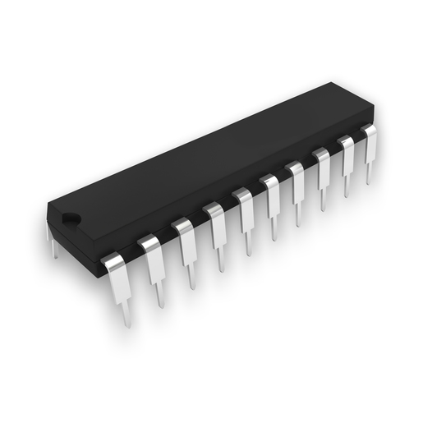
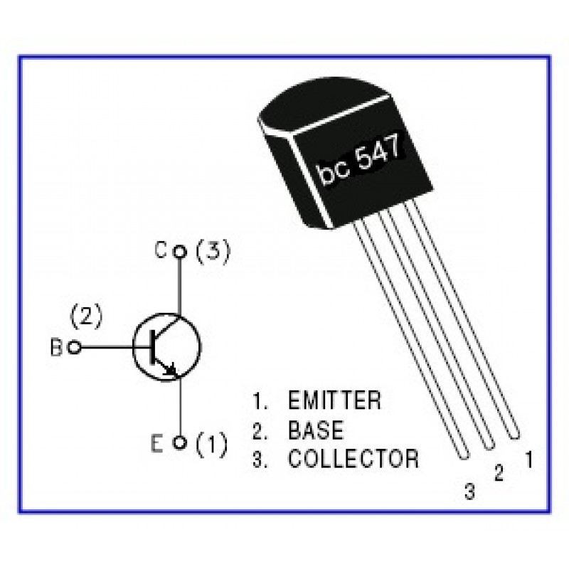
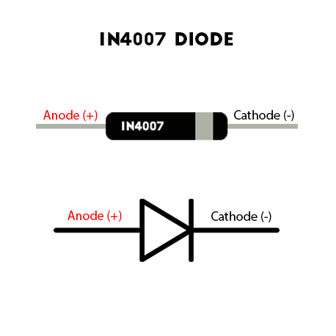
COMPONENTS REQUIRED
74LS 373 IC { OCTAL D – LATCH }
BC 547 TRANSISTORS
1N 4007 DIODES
SOUND BUZZER
10 PUSH BUTTONS
8 LEDS

Slide 5
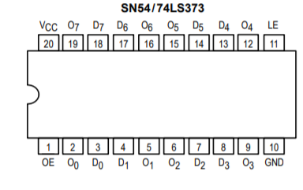
74 LS 373 IC
The IC 74LS373 is a transparent latch consists of a eight latches, with three state outputs for bus organized systems is a 20 pin .
IC comprises of eight input data lines (D0-D7) and eight output lines (O0-O7). The OE pin was meant for Output enable and LE pin for Latch enable.
And the rest two pins VCC for power supply and GND for Ground. Let’s move in to the working of latch IC 74LS373.
The IC 74LS373 comprises eight D flip flops through which the input was given to the each pins of the IC. The Flip flops data changes asynchronously when the Latch enable (LE) is in High state.

Slide 6
WORKING and connections
We connect the 8 switches to the inputs of the IC and 8 pull down resistors are connected the switches . The 8 corresponding outputs are connected to 8LEDs through 8 resistors.
Now, we take a transistor and connect its collector to the latch enable pin and its emitter is connected to ground. The base is connected to a resistor and we connect 8 diodes to the 8 outputs(see figure).
We connect a reset switch between Vcc and ground as shown in figure.
The buzzer is connected the common junction of 8 cathode pins of LEDs and the common diodes junction. Similarly , common anodes of diodes and leds are also connected as shown in figure. The common junction of 8 cathode pins is connected to ground.
The Vcc and ground connections are made wherever required.

Slide 7
WORKING and connections
The buzzers send the input to the LS373 IC which consists of 8 D-latches with common enable works at active HIGH.
This D-latches stores data of the player who pressed the button first and output it to the corresponding player LED.
The output signal is also sent to the transistor which acts like a switch to the enable
The transistor turns off the enable [5v] such that IC doesn’t take inputs further (i.e., from other players).

Slide 8

BLOCK DIAGRAM
INPUT PROCESS OUTPUT
8 push buttons
sends the input to
74LS373 IC.
1 reset button
Reset the circuit.
74LS373 IC
-Will accept to the input the cancel the any additional input.
Display the corresponding player LED
-audio alert for quiz master.

Slide 9
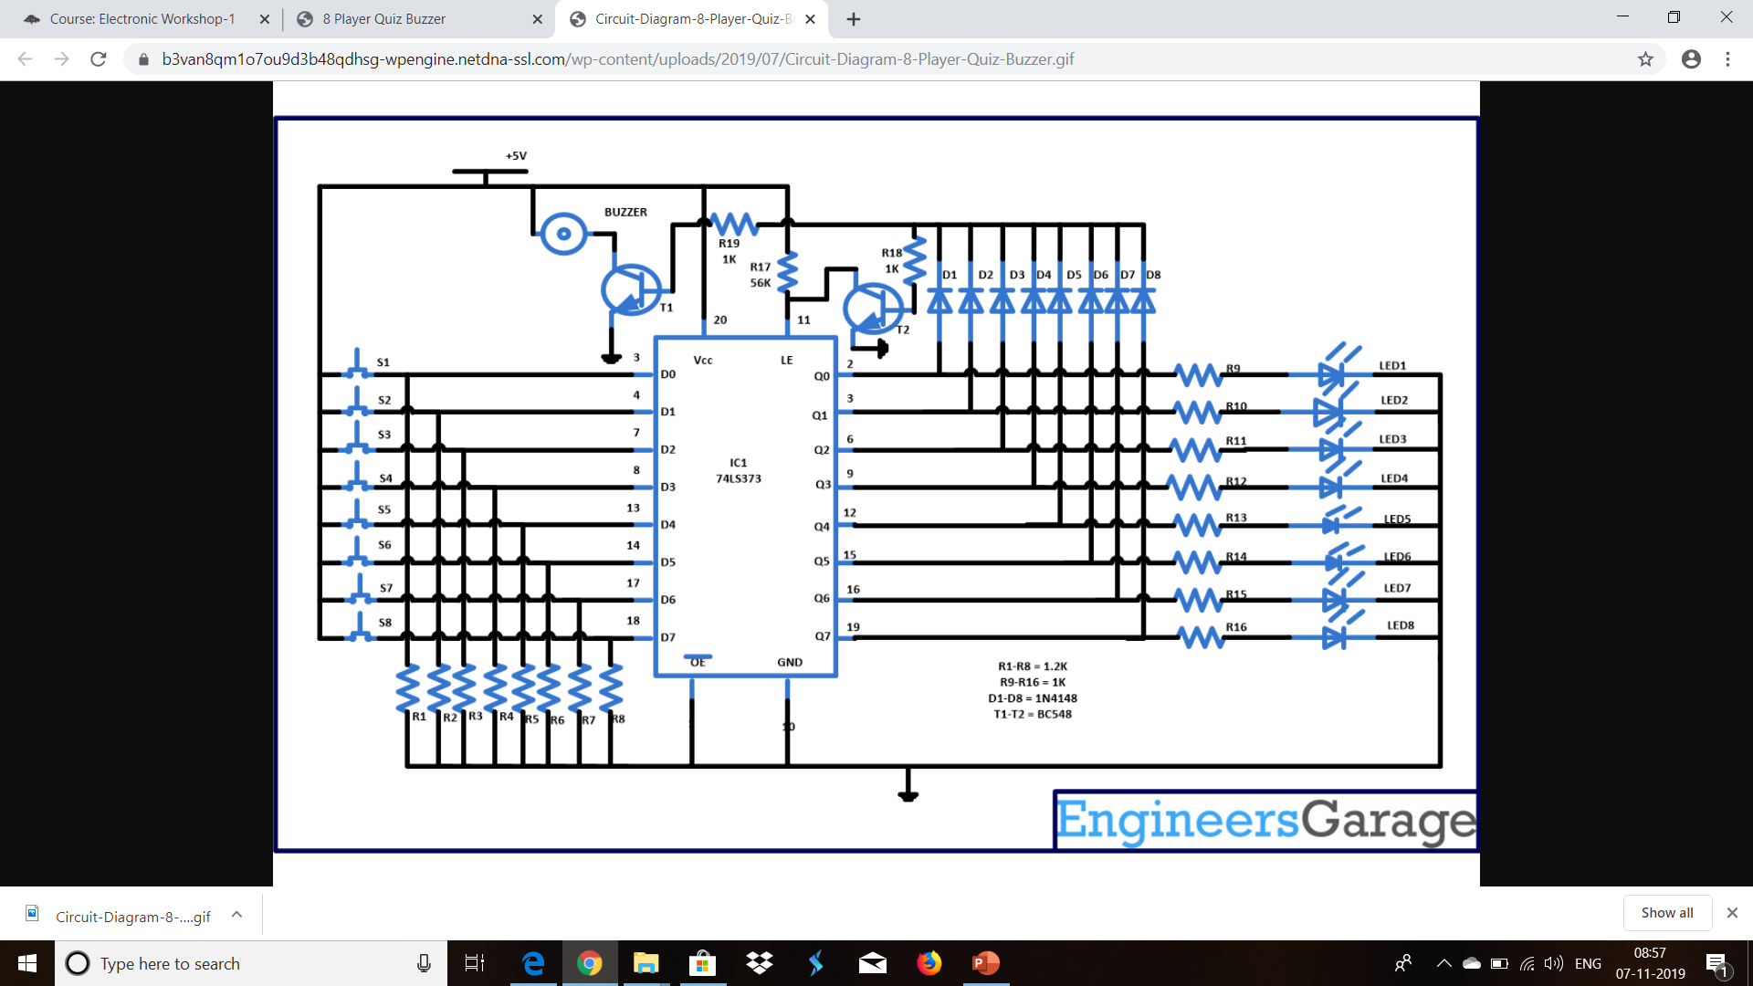
CIRCUIT DIAGRAM

Slide 10
TIME LINE FOllowed
FIRST WEEK
Check working of components,
Project slide
In the FIRST WEEK we check the components whether they are working properly or not, preparing the project presentation slide.
In the SECOND WEEK we fixedup the connections to the IC with LEDs and push buttons.
In the LATER WEEKS we gave the final touch up to the project.
Second Week
Fixed up connections IC with others
Later Weeks
Remaining connections and checking the output
CONCLUSION:
The deliverables of this project is to indicate the person who pressed the buzzer first when multiple buzzer presses happened.
The impact of the work is to learn the working function of IC’s, use of transistors and others.

Slide 11
THANK YOU

